Slide 1
XAML for Windows 10: ItemsControls
Daren May | President, CRANK211
Jerry Nixon| Developer Evangelist, Microsoft

Slide 2
Course Topics
XAML for Windows 10: ItemsControls
01 | ItemsControl Fundamentals
02 | Templates
03 | Tips and Tricks

Slide 3
Recommended Resources
https://dev.windows.com/
https://msdn.microsoft.com/en-us/library/windows/apps/windows.ui.xaml.datatemplate.aspx

Slide 4
02 | Templates

Slide 5
Module Overview
ItemsPanelTemplate
DataTemplate
ItemsTemplate, HeaderTemplate & FooterTemplate
TemplateSelectors

Slide 6
ItemsPanelTemplate

Slide 7
ItemsPanelTemplate
Typically contains a Panel-derived class
Cannot be virtualizing if used in a group-style panel
VirtualizingStackPanel

Slide 8
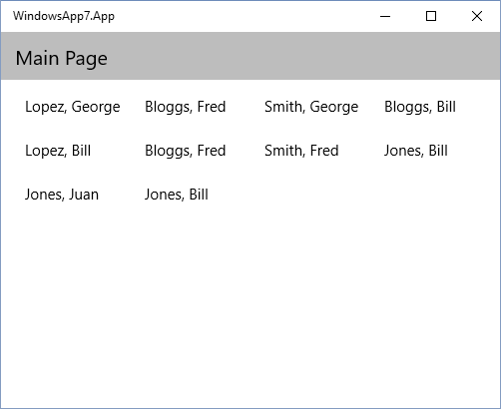
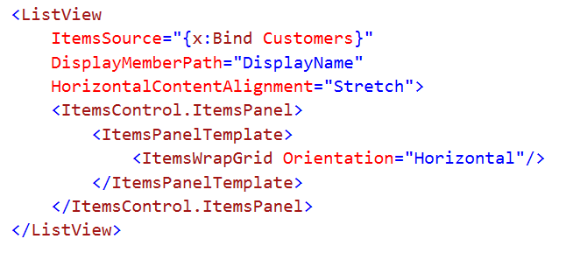
ItemsPanelTemplate
Defines the panel used to layout the items in an ItemsControl
Can be defined inline:

Slide 9
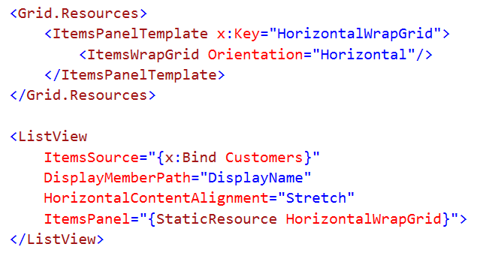
ItemsPanelTemplate
Can be defined as a resource:

Slide 10
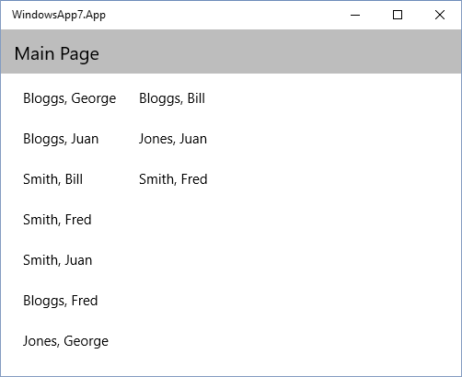
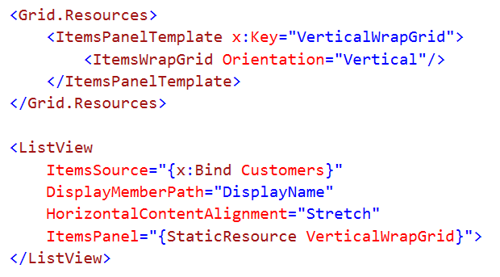
ItemsPanelTemplate
Using Vertical orientation in ItemsWrapGrid:

Slide 11
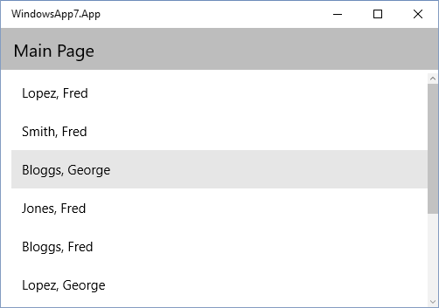
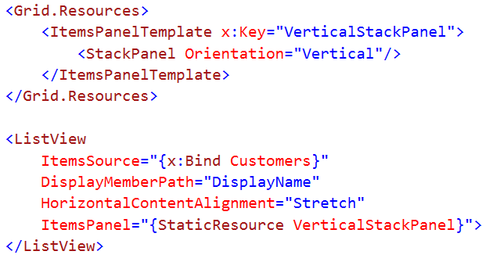
ItemsPanelTemplate
Using Vertical orientation with a StackPanel:

Slide 12
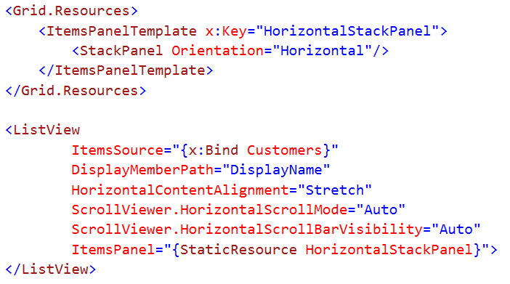
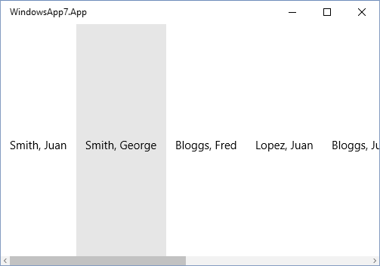
ItemsPanelTemplate
Using Horizontal orientation with a StackPanel:

Slide 13
Data Templates

Slide 14
What is a DataTemplate?
Describes the visual structure of a data object.
Use data binding to display the data values.
Useful for defining how data is presented in repeaters

Slide 15
Where are DataTemplates used?
ItemsControl.ItemTemplate
ListView, GridView, ListBox
ContentControl.ContentTemplate
Button, Frame, SettingsFlyout)
HeaderTemplate and FooterTemplate properties of various items control classes
ItemsPresenter.HeaderTemplate and ItemsPresenter.FooterTemplate
HeaderTemplate and FooterTemplate
RichEditBox, TextBox
HeaderTemplate
ComboBox, DatePicker, Hub, HubSection, Pivot, Slider, TimePicker, ToggleSwitch; some of these also have FooterTemplate

Slide 16
ItemsTemplate, HeaderTemplate & FooterTemplate

Slide 17
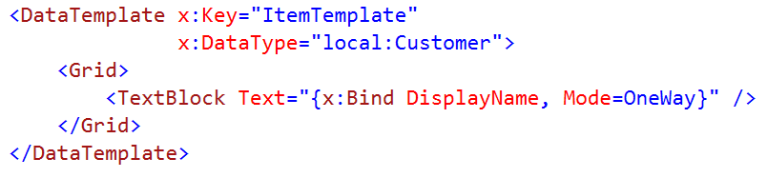
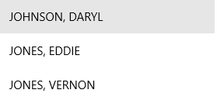
What is an ItemsTemplate?
DataTemplate that defines how each item is displayed

Slide 18
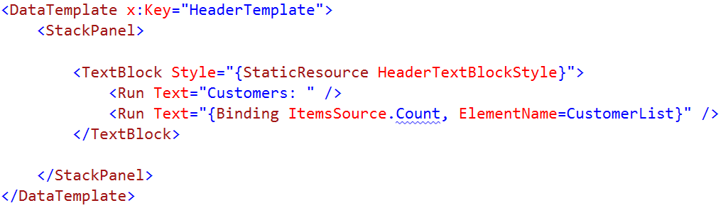

What is a HeaderTemplate?
Defines the look of the control header

Slide 19
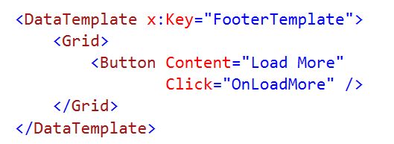

What is a FooterTemplate?
Defines the look of the control footer (surprise!)

Slide 20
Template Demos
Notes:
0. Add ItemTemplate
1. Run with no data
2. Introduce header template with [empty] data
3. Introduce footer with [load more]
4. ItemsPanelTemplate, children transitions / orientation
5. Template selector

Slide 21
TemplateSelectors

Slide 22
What is a TemplateSelector?
Derives from DataTemplateSelector
Can use code to choose which template is to be applied
Usually created as a resource

Slide 23
TemplateSelector Demo

Slide 24
Summary
ItemsPanelTemplate
DataTemplate
ItemsTemplate, HeaderTemplate & FooterTemplate
TemplateSelectors

